Slide 1
Predicting Wildfire Size Category
Madeline Vossbrinck

Slide 2
AGENDA
Background
Data and Tools
Methodology and Key Metrics
Results
Conclusions and Next Steps

Slide 3
BACKGROUND
2015 Fire Damage
3,280 deaths
15,700 injuries
$15.1 billion in losses (2018 dollars)
Source: https://www.usfa.fema.gov/data/statistics/#tab-4
Is it possible to predict which fires will become large so that more resources can be diverted to extinguishing them?

Slide 4
DATA SET
TOOLS
US wildfires between 2000-2015
At least 5 hours to contain
At least 0.25 acres large
Target:
Small fires (<= 10 acres)
Large fires (> 10 acres)
Features
Location
Fire Cause
Discovery Date
Pandas
Numpy
Matplotlib
Seaborn
Scipy
Statsmodels
Sklearn
XGBoost
Tableau

Slide 5
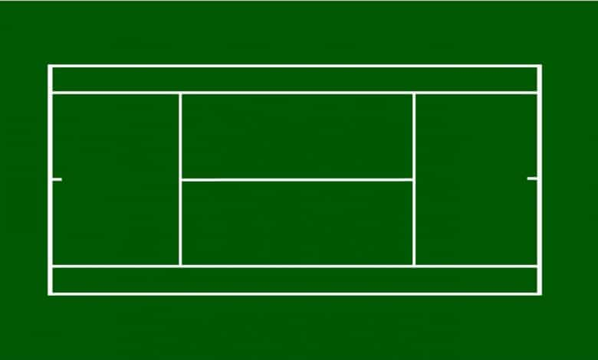
SIZE COMPARISONS
0.25 Acres
4 TENNIS COURTS

Slide 6
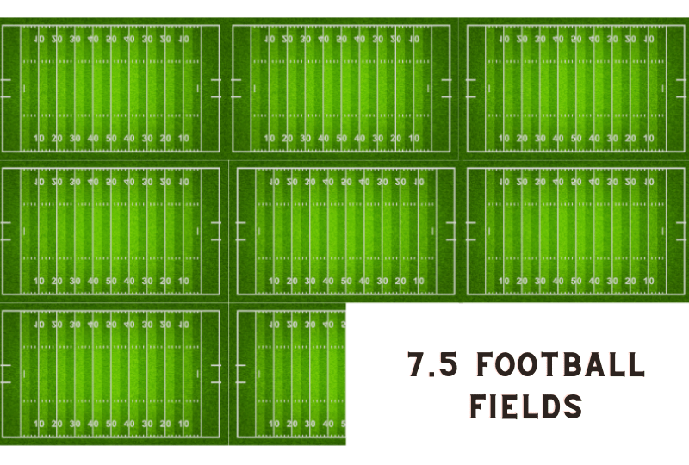
SIZE COMPARISONS
10 Acres

Slide 7
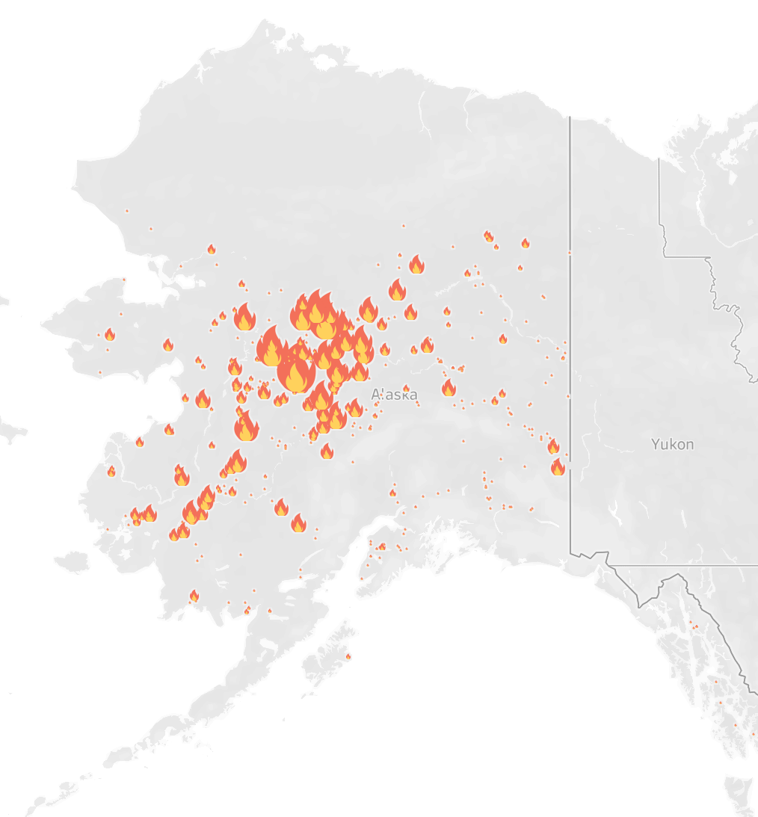
Acres Burned by State 2000-2015
Alaska Fires of 2015
Alaska | 25,722,736
Idaho | 9,976,198
California | 7,768,999
Oregon | 6,793,892
Nevada | 5,929,174
Texas | 4,801,147
Montana | 4,685,209
Arizona | 3,938,123
Washington | 3,532,895
New Mexico | 3,224,057
The largest fire was in 2012 in Oregon. It burned 558,198 acres which is larger than New York City and Los Angeles combined.
7

Slide 8
KEY METRICS
RECALL
PRECISION
F2 SCORE
What percent of the actual large fires are predicted correctly?
What percent of fires predicted to be large fires actually are large fires?
Balances recall with precision, weighs recall as twice as important

Slide 9
MODEL RESULTS
Model Type | Features | Recall | Precision | F2 Score
Logistic | Fire Cause | 0.399 | 0.565 | 0.424
Logistic | Region | 0.454 | 0.636 | 0.482
Logistic | Latitude and Longitude | 0.017 | 0.646 | 0.021
Logistic | Discovery Day of Year (DOY) | 0.138 | 0.630 | 0.163
Logistic | Fire Cause and Region | 0.485 | 0.636 | 0.509
Logistic | Fire Cause, Region, and Discovery DOY | 0.486 | 0.635 | 0.519
KNN | Fire Cause, Region, and Discovery DOY | 0.457 | 0.515 | 0.466
Random Forest | Fire Cause, Region, Discovery DOY, Discovery Time, Discovery Date, Latitude, and Longitude | 0.610 | 0.695 | 0.625
XGBoost | Fire Cause, Region, Discovery DOY, Discovery Time, Discovery Date, Latitude, and Longitude | 0.620 | 0.701 | 0.635

Slide 10
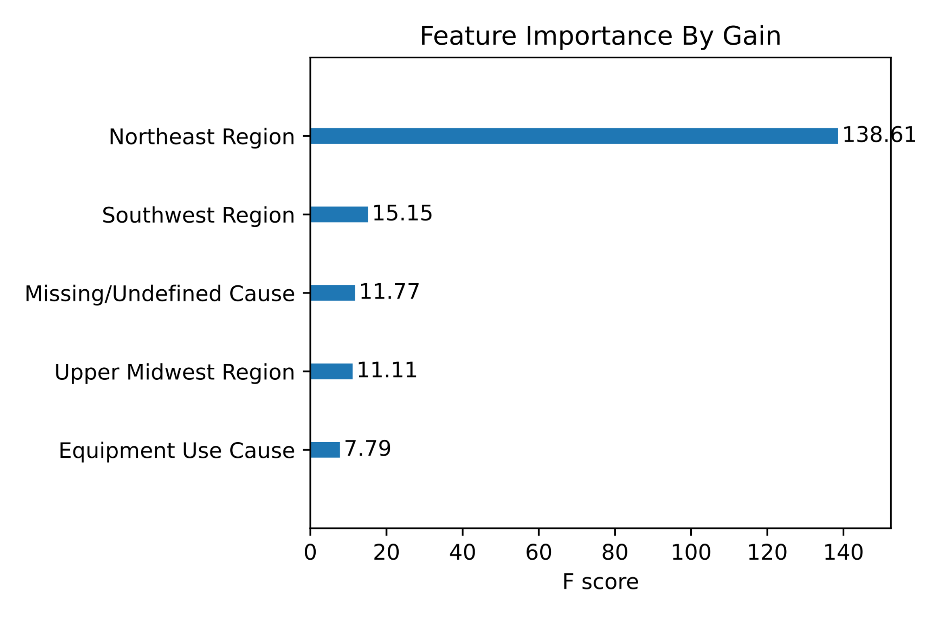
XGBOOST MODEL
Recall | Precision | F2 Score
0.620 | 0.701 | 0.635
n_estimators | 30,000
max_depth | 10
learning_rate | 0.1
subsample | 0.8
min_child_weight | 2
colsample_bytree | 0.8

Slide 11
PREDICTIONS
Fire Size Class | Size Range | % Correct Predictions
C | 10 - 99.9 Acres | 57%
D | 100 – 299.9 Acres | 68%
E | 300 – 999.9 Acres | 70%
F | 1000 – 4999.9 Acres | 62%
G | 5000+ Acres | 67%

Slide 12
CONCLUSIONS AND NEXT STEPS
Conclusions:
Current model could be a tool that is useful in making a decision about resources
Should be used in conjunction with other tools and information not available in data set
Next Steps:
Acquire updated data
Work on improving predictions on largest fires
Try predicting fire size category based on other thresholds
Use multi-class target

Slide 13
Questions?

